Slide 1
UFC Win Predictions Project
By: Janalyn Lao, Kyle Bistrain, Daniel Redfern, and Nickzad Bayati
Notes:
Kyle

Slide 2
Disclaimer
The next slide contains violent content involving UFC fighting!
If you don’t want to see the following video, please step outside of the room and we will let you in the room after the video
Notes:
Kyle

Slide 3
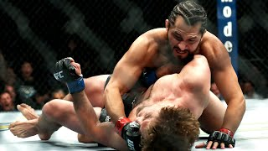
UFC Knockout
Notes:
Kyle

Slide 4
Project Overview
Data Collection and Cleaning
Data Explorations
Findings
Obstacles
Reflection

Slide 5
Data Collection and Cleaning
Collection
UFC-Fight historical data from 1993 to 2021 (kaggle)
Cleaning the Data
Filter out unnecessary columns
Drop all rows that contain NA
Convert data to numerical data
Categorical variables were made into dummy variables
Notes:
Unnecessary columns:
Fighter’s name
Fight location and date
Convert data to numerical data
Winner column - Red, Blue
Draw removed bc not enough data
Dummy variables
Weight class
R & B stances
Binary dummy variables make it easier to interpret the impact of each category on the model’s predictions

Slide 6
Explanatory Variables
R_ and B_ prefix signifies red and blue corner fighter stats respectively
_opp_ containing columns is the average of damage done by the opponent on the fighter
Stance is the stance of the fighter (orthodox, southpaw, Switch)
Height_cms is the height in centimeter
Reach_cms is the reach of the fighter (arm span) in centimeter
Weight_lbs is the weight of the fighter in pounds (lbs)
age is the age of the fighter
title_bout Boolean value of whether it is title fight or not
weight_class is which weight class the fight is in (Bantamweight, heavyweight, Women's flyweight, etc.)
current_lose_streak is the count of current concurrent losses of the fighter
current_win_streak is the count of current concurrent wins of the fighter
draw is the number of draws in the fighter's ufc career
wins is the number of wins in the fighter's ufc career
losses is the number of losses in the fighter's ufc career
total_rounds_fought is the average of total rounds fought by the fighter
total_time_fought(seconds) is the count of total time spent fighting in seconds
total_title_bouts is the total number of title bouts taken part in by the fighter
win_by_Decision_Majority is the number of wins by majority judges decision in the fighter's ufc career
win_by_Decision_Split is the number of wins by split judges decision in the fighter's ufc career
win_by_Decision_Unanimous is the number of wins by unanimous judges decision in the fighter's ufc career
win_by_KO/TKO is the number of wins by knockout in the fighter's ufc career
win_by_Submission is the number of wins by submission in the fighter's ufc career

Slide 7
Response Variable
Winner is the gloves color of the winner
Red (0)
Blue (1)

Slide 8
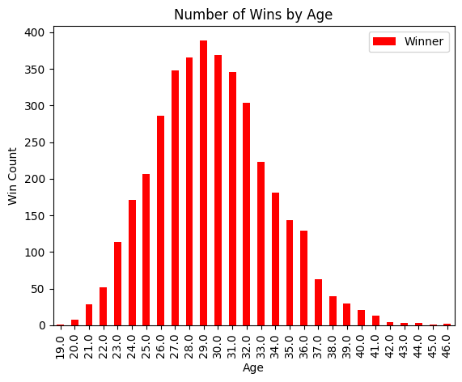
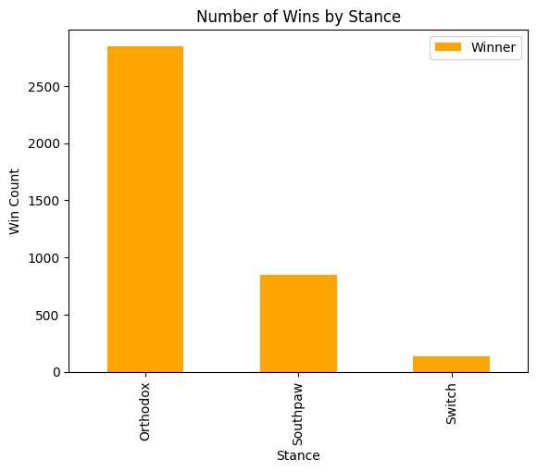
Data Exploration
Notes:
Nick

Slide 9
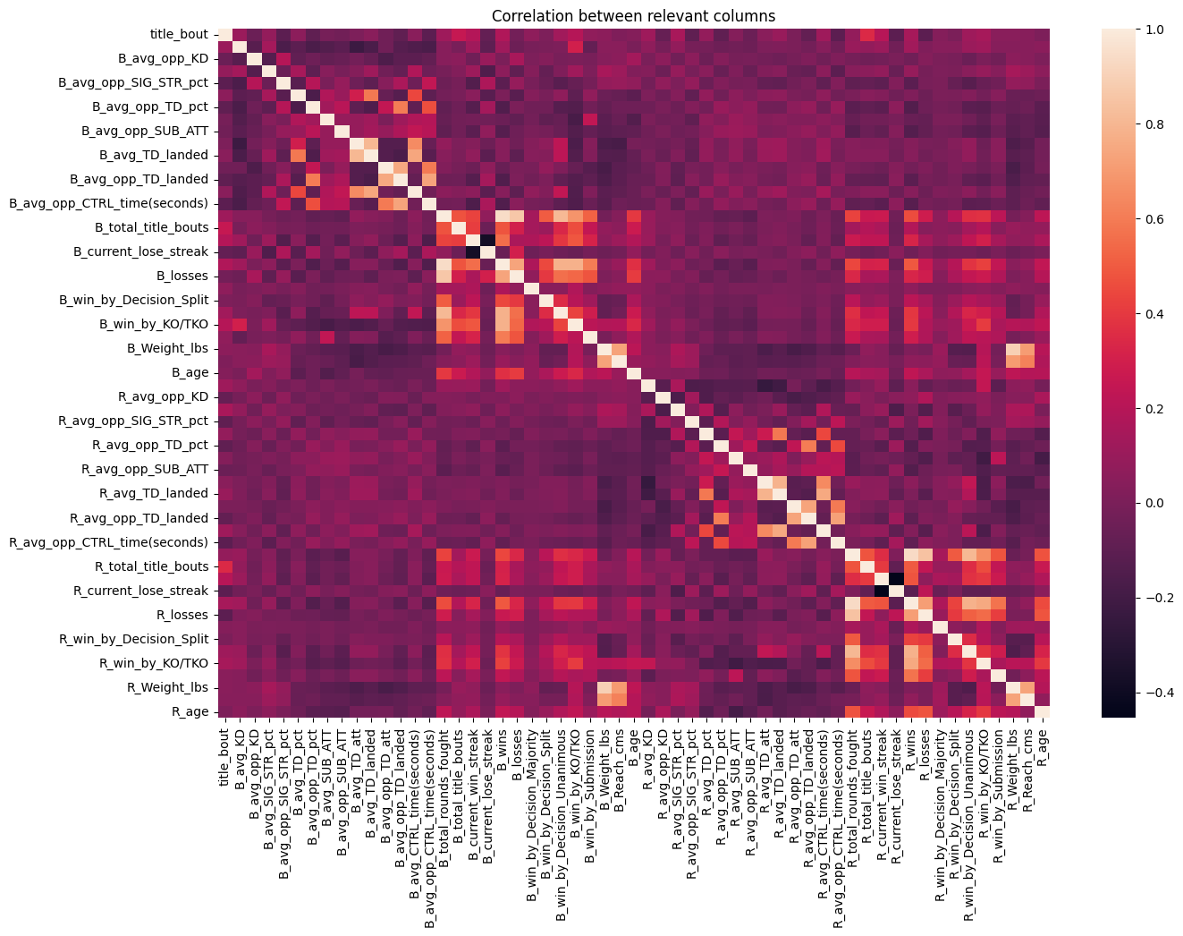
Data
Exploration
(Correlation)
Notes:
Nick

Slide 10
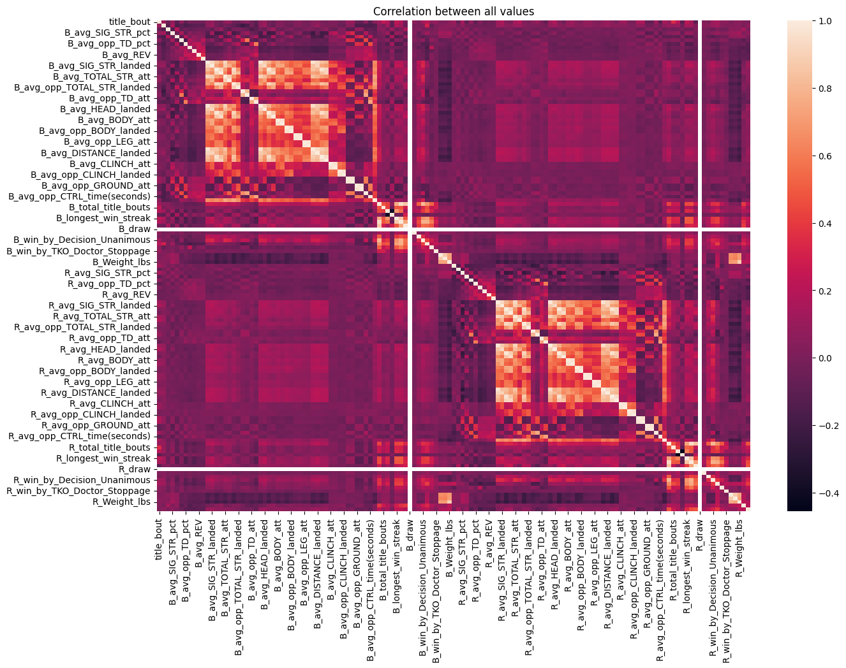
Data
Exploration
(Full Correlation)
Notes:
Nick

Slide 11
Most Positively and Negatively Correlated Values
B_total_rounds_fought | B_wins | 0.9388
R_total_rounds_fought | R_wins | 0.9364
B_Weight_lbs | R_Weight_lbs | 0.8931
B_losses | B_total_rounds_fought | 0.8634
R_losses | R_total_rounds_fought | 0.8448
R_avg_SUB_ATT | R_win_by_KO/TKO | -0.2079
B_avg_KD | B_avg_TD_att | -0.2244
R_avg_KD | R_avg_TD_att | -0.2476
B_current_lose_streak | B_current_win_streak | -0.3793
R_current_lose_streak | R_current_win_streak | -0.4540

Slide 12
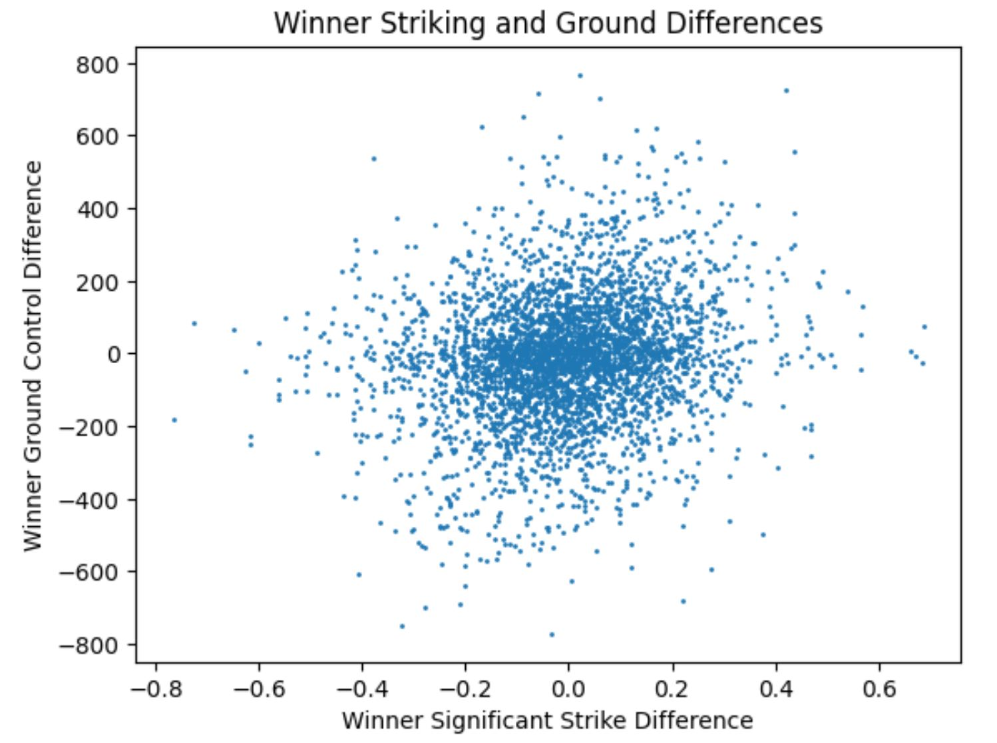
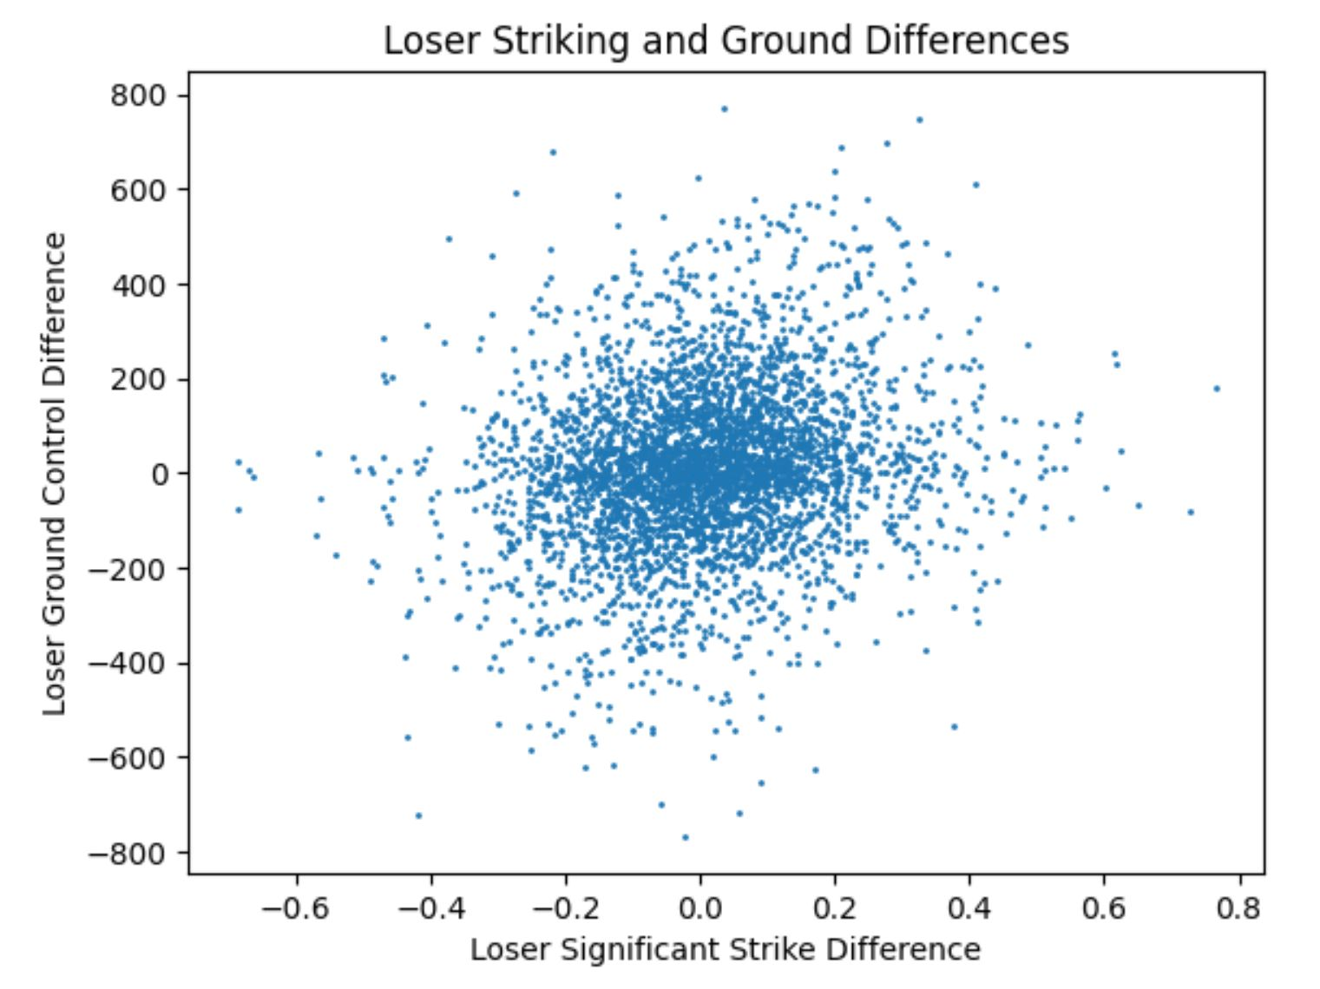
Expected Data Trends:

Slide 13
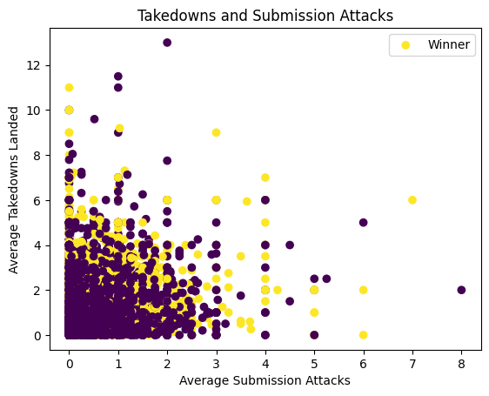
Key takeaways: It is impossible to determine a pattern in the sample data and interpret the sample
It is hard to find trends in whether a fighter wins, draws or a loses in this data sample.

Slide 14
Findings
Our Neural Network had an input size of (4,) with the variables ['R_age', 'B_age', 'R_losses', 'B_losses']
We used a 4 layer model with 4 perceptrons on the 1st, 2nd and 3 layers.
The last layer has an output size is (2,) with the sigmoid function.
Our batch size was 20 and epoch size was 5 to prevent overfitting.
In our best trial, the testing data set correctly predicted the outcome (Blue wins or Red wins) of the test_training_data 66.9% of the time.
Our loss function was binary_crossentropy and
Evaluation Accuracy: 0.669
Evaluation Loss: 0.614
According to pinnacle.com a sports betting website, 62% of the time, sportsbooks favorites win. That number goes up to 67% with corrections from everyone betting on the fight.
Notes:
Output size
3 for Red, Blue, or Draw
Kyle

Slide 15
Major Obstacles
We originally wanted to predict stock prices, but we had trouble finding old market data without spending money on premium data.
Finding data files with a large number of explanatory variables to pick from.
Picking explanatory variables
Figuring out that reducing using PCA was not possible because our model is a mix of categorical and continuous numeric variables.
This is because categorical variables do not have a variance structure, we can’t reduce the dimensionality without dropping important explanatory variables (ex: Age (discrete) )
Therefore we just used our best judgement to eliminate variables using the correlation matrix of all the variables.
This contributes to the high loss value of 0.614
Notes:
Kyle

Slide 16
Algorithm Analysis: Neural Networks
Pros:
Easy and straightforward implementation
Flexible architecture
Cons:
prone to overfitting
not easily interpretable
Hyperparameter tuning
Limited scalability for larger datasets
Notes:
Flexible architecture
Easy customization of NN
Layers
Neurons per layer
Epochs
Batch size
Not easily interpretable
Regression - Easily interpretable bc of prediction formula
Hyperparameter tuning
neuron amount per layer
Epoch size
dimensionality
Limited scalability
NN are not suitable for large-scale or high-dimensional datasets
Originally had input size of 80

Slide 17
Reflection
Overall, our model performed well considering the difficulty of accurately predicting UFC fights
Other explanatory variables that could affect a fight’s outcome were not included
In the future, to improve our model, we could research methods to tune our hyperparameters to maximize accuracy and minimize loss.
We could also work on ways of reducing dimensionality
Notes:
Other possible explanatory variables that we did not have access to are:
fighter nervousness levels
sleep quality
Previous injuries
Nutrition
Years of training/experience
Judges
reducing dimensionality
Once reduced, we had more consistent loss and accuracy

Slide 18
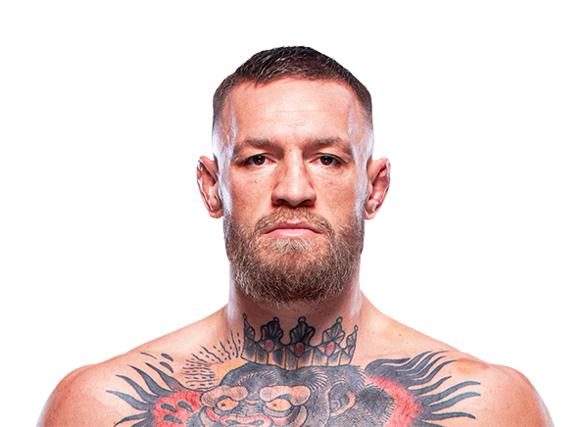
Thank you for Listening to our Presentation!
Notes:
Link: https://www.espn.com/mma/fighter/_/id/3022677/conor-mcgregor

